Slide 1






Flook

Slide 2



Flook

Slide 3
Situation Recipe View
Today Recipe View

Slide 4
Mood Recipe View
Today Recipe View

Slide 5
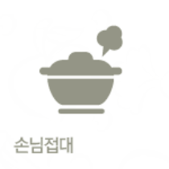




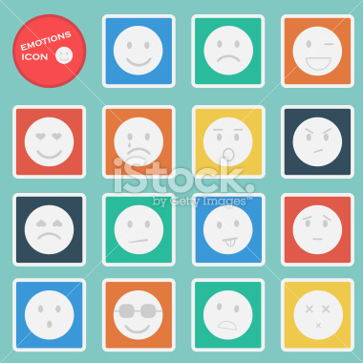





Slide 6



